Slide 1
Terova · CO₂ Emissions Analytics
Tradewind — see the carbon in every route, and pick a better one
290 movements · 3 years · 30 lanes · every number traced to a workbook cell
August 2026

Slide 2
01
The shift
WHY THIS DECK IS SHORT
Stop reporting the number. Start changing the route.
The portal is built and running. Every screen in this deck is a real screenshot.
Every number on it comes from your own file, Transport Downstream-V02.xlsx. No models. No made-up data. Each figure shows the cell it came from.
Booking stays in your systems. Tradewind prices the choice and shows the proof. It does not book anything.
02
Core capabilities
What the portal does
03
Core personas
Who uses it, and for what
04
The four screens
A walk through the live product
What happens next
4
3
290
1
05
How we take it live
screens
roles
movements
source file

Slide 3
Stop reporting the number. Start changing the route.
THE SHIFT
You already know your transport footprint. What you cannot ask today is: what would this shipment have cost in CO₂e if it went another way? Tradewind answers that from your own records.
565 t
50.2 t
30
100%
CO₂e in scope
can be avoided
lanes priced
traced to a cell
290 movements over three years
8.9% of the total
destination port × product
open any figure down to the sheet
WHAT CHANGES
Estimated → Measured
Totals → Shipments
Charts → Choices
We use the factors your workbook already states. Road 0.5928 kg CO₂e per truck run. Rail 0.00996 and sea 0.0084 per tonne-km. Air 1.58.
Every sea leg is joined back to its road and rail legs. You see the whole journey — factory, depot, port, port — with each leg costed on its own.
An option only appears if your workbook records every leg of it. Each one says how many shipments have already gone that way.
Source: Transport Downstream-V02.xlsx · three reporting years, July to June · each year ties back to the total the sheet prints in cell D53.

Slide 4
Core capabilities
WHAT THE PORTAL DOES
Four screens and three things that run across all of them. Nothing on any screen is guessed — if the workbook has no column for it, the portal does not show it.
DECIDE
UNDERSTAND
PRIORITISE
Control Tower
Emission Hotspots
Product & Destination Lanes
See every shipment on a map. Pick one and compare the route it took with the greener option your own data proves.
The same CO₂e, cut by product, port, gateway, market, mode and month.
Find the lanes where one routing change saves the most carbon.
REPORT
ASSIST
GOVERN
Footprint & Evidence
Ask Tradewind
Filters, alerts & proof
The reported total, tied line by line back to your file. Export it as CSV or PDF.
A chat panel that answers only from the numbers on screen — and says so when it cannot answer.
Filter anything. Catch air freight, part-load trucks and duplicate rows. Open any figure down to its cell.
What is deliberately missing: no carrier or vendor scorecard, and no buying persona. The workbook names no vendor, carrier or forwarder, so there would be nothing real to rank.

Slide 5
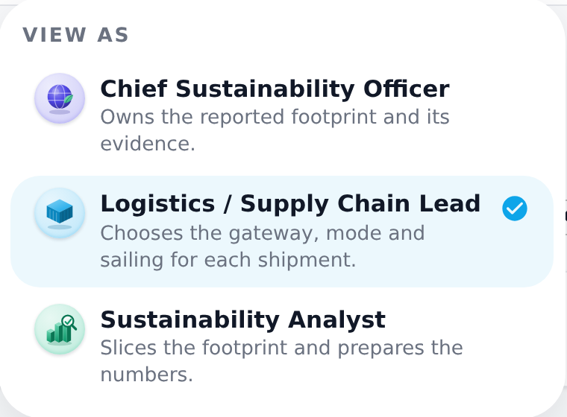
Three roles, one footprint
WHO IT IS FOR
The switcher changes the view, not the data. It sets the landing screen and the headline numbers. To narrow the rows, use the filter bar.
Chief Sustainability Officer
LANDS ON · ESG REPORTING
THE “VIEWING AS” SWITCHER
CS
565 t over three years. The latest year is down 40.4% on the first. Every year ties back to the sheet.
Owns the reported number and its proof.
Logistics / Supply Chain Lead
LANDS ON · CONTROL TOWER
LS
50.2 t can be avoided. 176 ranked suggestions explain exactly how.
Picks the port, mode and sailing for each shipment.
Sustainability Analyst
LANDS ON · EMISSION HOTSPOTS
SA
One click points the portal at the person in the room. Useful in a demo, and the same control every user gets on day one.
Slices the data and prepares the numbers.
565 t cut six ways, month by month, at 9.26 g CO₂e per tonne-km.
Everyone sees the whole company footprint. There is no buying persona because the workbook names no vendor or carrier — that role would have nothing to act on.

Slide 6
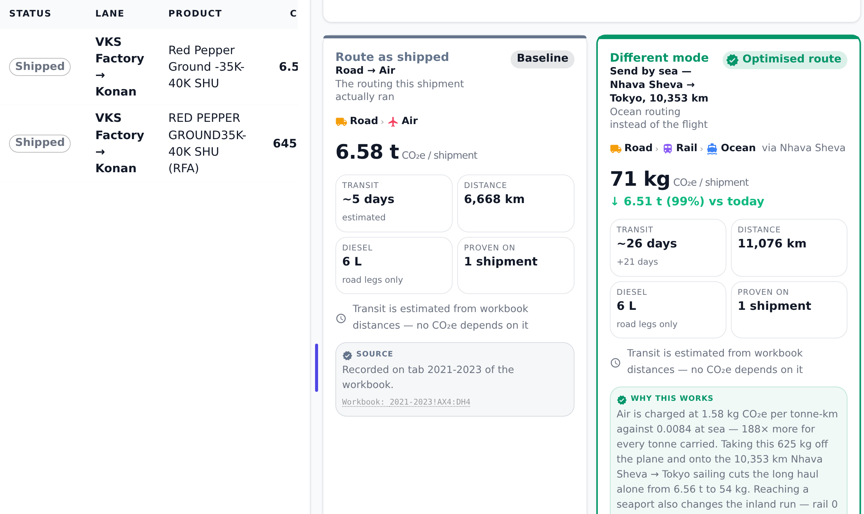
Control Tower — pick the shipment, see the better route
SCREEN 01 · LOGISTICS / SUPPLY CHAIN LEAD
1
Pick a shipment
Click a lane on the map or a row in the register. You get the route it took, next to the best option your own data proves.
2
See the saving
This air shipment cost 6.58 t CO₂e. By sea it is 71 kg. That is 6.51 t less — a 99% cut.
3
Check the trade-off
Sea takes about 26 days instead of 5. Both cards name the workbook cell behind every figure.
50.2 t avoidable network-wide

Slide 7
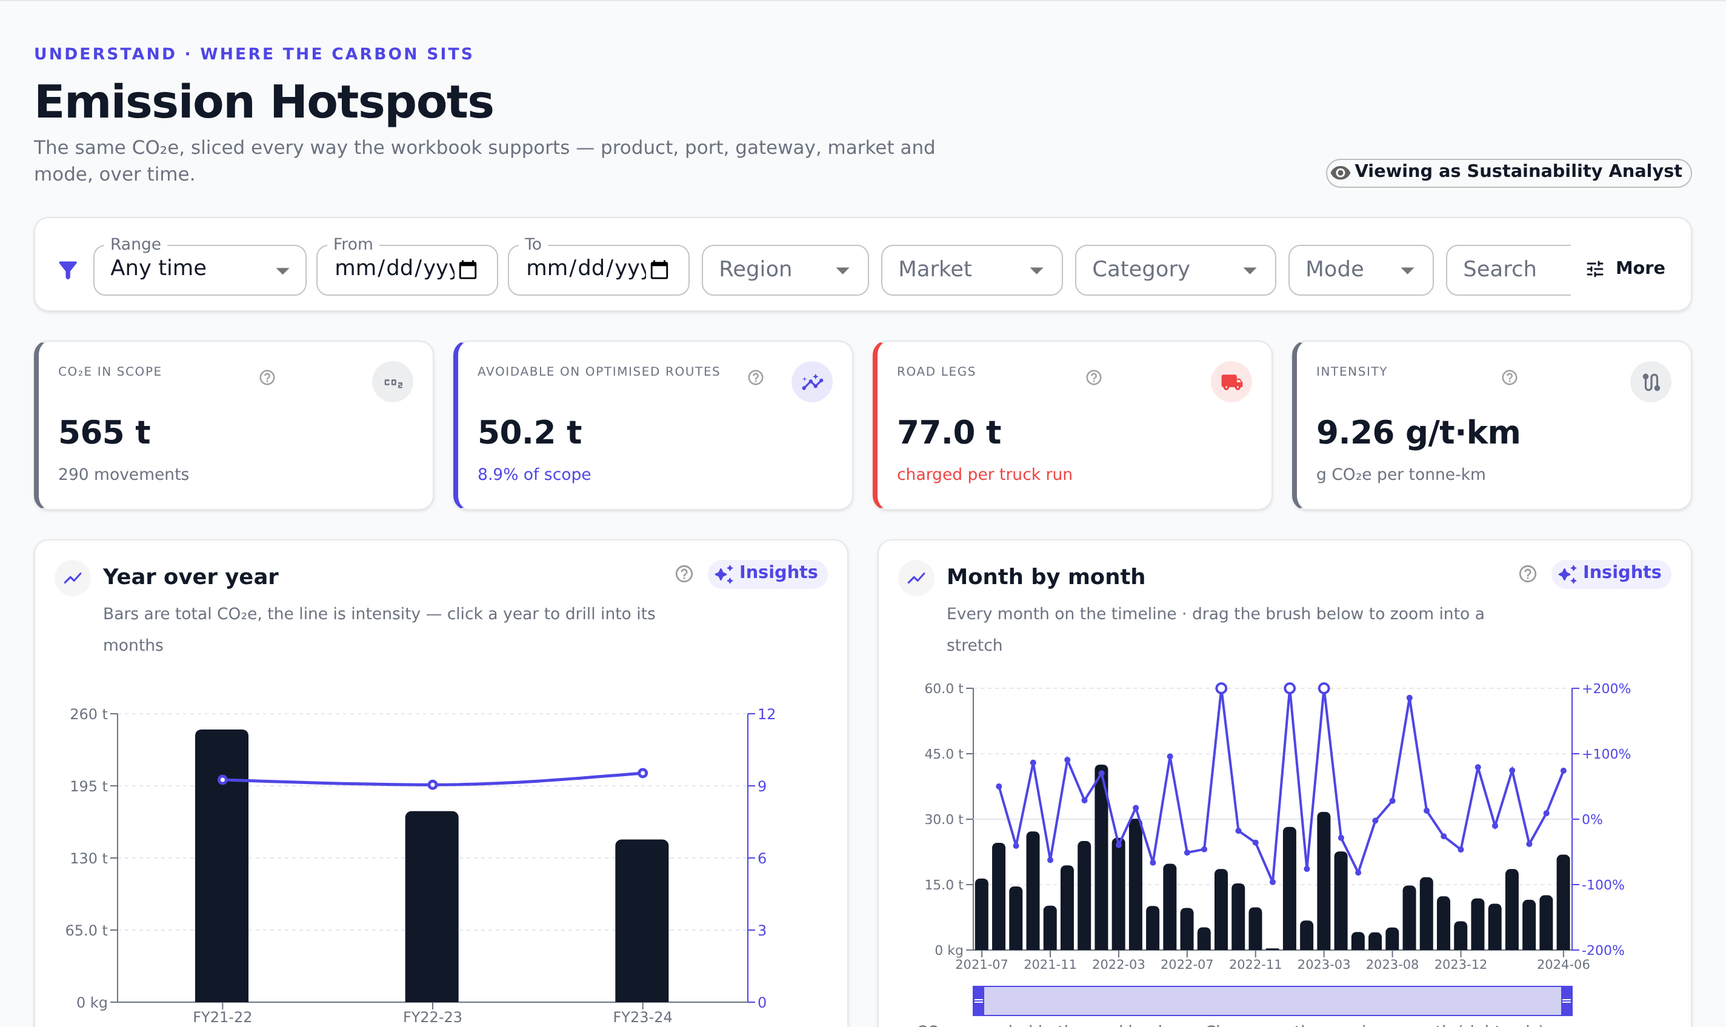
Emission Hotspots — where the carbon actually sits
SCREEN 02 · SUSTAINABILITY ANALYST
1
Growth, or waste?
Total CO₂e is drawn against intensity. Shipping more is not the same as shipping badly, and the chart keeps them apart.
2
Road is the big lever
77.0 t sits in road legs. Road is charged per truck run, so a 400 kg load costs the same as a 25 t one.
3
Year, then month
Click a year to open its months. Drag the brush to zoom into any stretch of the 36 months on record.
50.2 t of the 565 t is avoidable

Slide 8
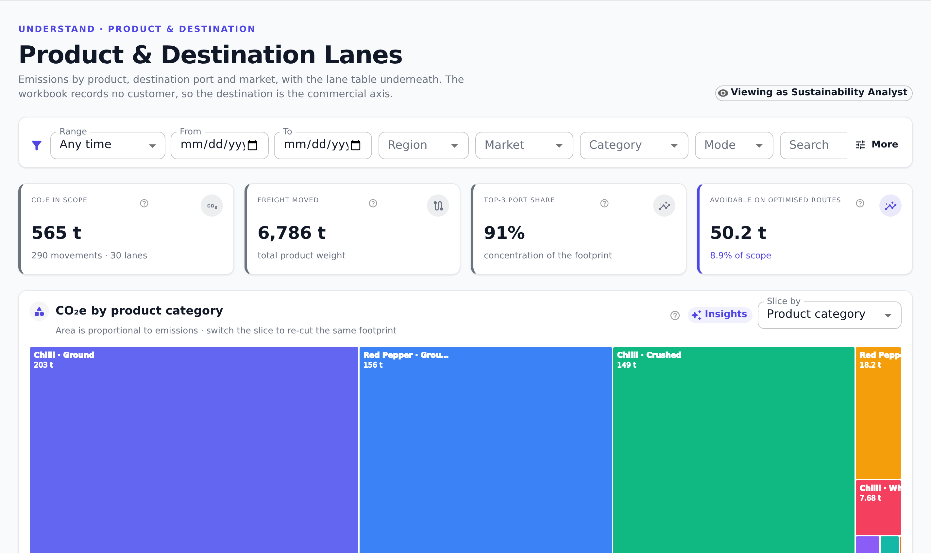
Product & Destination Lanes — where to act first
SCREEN 03 · EVERY ROLE
1
The carbon is concentrated
91% of it sits in three destination ports. Three products carry most of the rest.
2
Recut the same total
Switch the slice to see the same 565 t by product, port, gateway, market or mode.
3
Rank the work
Lane priority plots emissions against what can be avoided, so the best first move stands out.
6,786 t of freight, 30 lanes

Slide 9
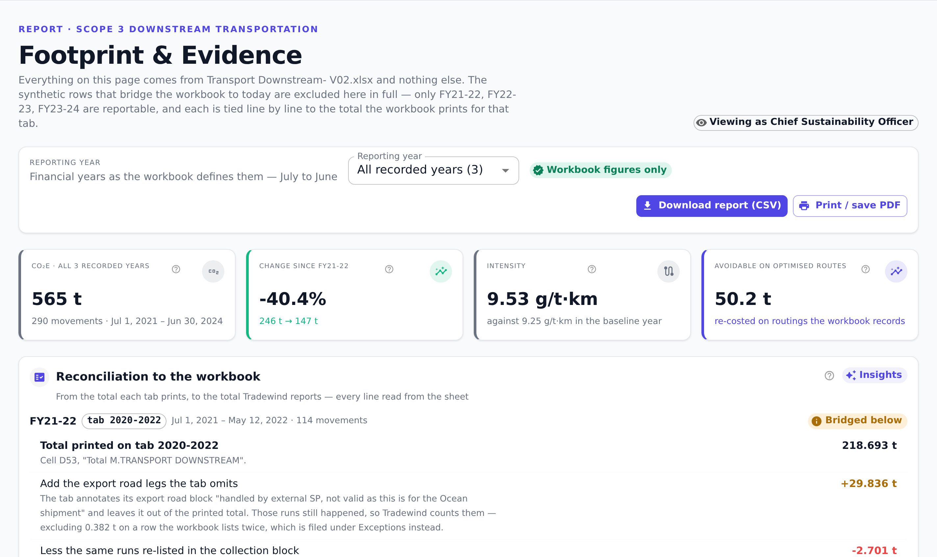
Footprint & Evidence — the number, and its proof
SCREEN 04 · CHIEF SUSTAINABILITY OFFICER
1
The reported number
565 t over three years. The latest year is down 40.4% on the first, at 9.53 g CO₂e per tonne-km.
2
Tied to your sheet
FY21-22 prints 218.693 t. Add the 29.836 t of road legs it leaves out, take off 2.701 t counted twice, and it lands on 245.828 t.
3
Ready for audit
Factors, method, assumptions and the rows that disagree with themselves. Export to CSV or PDF.
Three years, each tied to the file

Slide 10
What happens next
FROM WORKING DEMO TO CONNECTED PLATFORM
The portal runs today on the transport workbook. It was built for the swap: no screen reads data directly, so moving to live systems changes one setting, not the whole app.
PHASE 1
PHASE 2
PHASE 3
PHASE 4
Prove
Connect
Operate
Extend
2–3 weeks
4–6 weeks
6–8 weeks
ongoing
Walk the four screens with your numbers. Agree the factors, the boundary and the rows that need fixing at source.
Point the same screens at live shipment data. Add carrier, customer and freight cost as your systems supply them.
Route options in the weekly planning rhythm. Exceptions cleared as they appear. The evidence pack generated, not assembled.
Inbound and upstream transport on the same model, supplier factors, and the record needed for carbon credit talks.
WHAT WE NEED FROM TEROVA
WHAT TEROVA GETS FIRST
One owner for the reporting boundary, read access to the shipment data, and a decision on the rows that disagree with themselves.
A footprint you can defend, tied back to the source — and a ranked list of the route changes worth the most carbon.

Slide 11
Thank You

